Slide 1
COMPUTING IV
Assignments Portfolio
Phong Vo

Slide 2
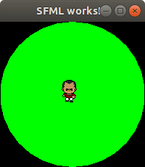
ps 0: HELLO WORLD WITH SFML
The SFML library and the definitions of sprite and texture
Graphical supports from SFML library, used in drawing shapes,
rendering windows, color management
sf::RenderWindow window(sf::VideoMode(200, 200), "SFML works!");
sf::CircleShape shape(100.f);
shape.setFillColor(sf::Color::Green);
How to make an object, such as a sprite, moving on the texture by pressing a navigation key
if (sf::Keyboard::isKeyPressed(sf::Keyboard::Right)){
sprite.move(1, 0);}
How to load a sprite as an object into the program
// load the sprite
sf::Texture texture;
if (!texture.loadFromFile("sprite.png")) {return EXIT_FAILURE;}
sf::Sprite sprite(texture);
sprite.setTexture(texture);
Interested thing(s):
Manipulating the sprite on the texture by the functions of “move”, “setRotation”

Slide 3
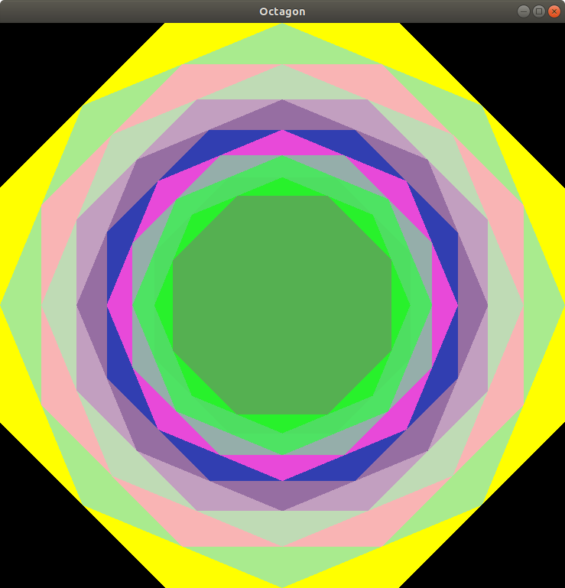
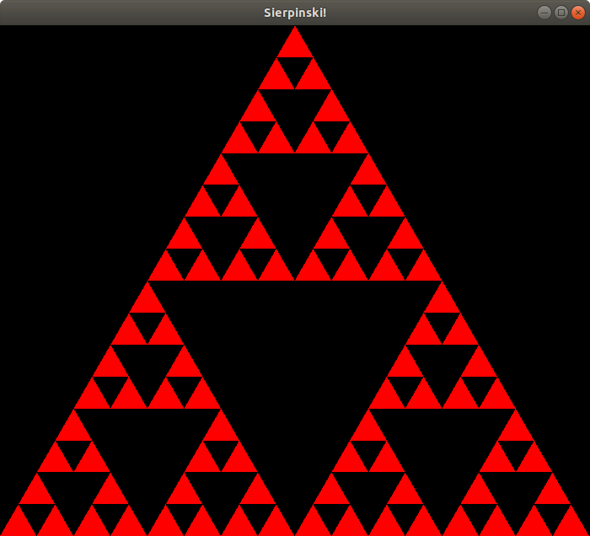
ps 1: RECURSIVE GRAPHICS
class Octagon: public sf::Drawable {
public: //Constructor that takes size and depth
Octagon(int side, int depth); //Constructor that takes eight points and depth
void oct_tree(sf::Vector2f topL, sf::Vector2f leftUp, sf::Vector2f leftDn, sf::Vector2f downL, sf::Vector2f downR, sf::Vector2f rightDn, sf::Vector2f rightUp, sf::Vector2f topR, int depth);
…
}
class Sierpinski: public sf::Drawable {
public:
Sierpinski(int side, int depth);
void sierpinski_tree(sf::Vector2f top, sf::Vector2f left,
sf::Vector2f right, int depth);
…
}
Learnt thing(s):
Constructor for an octagonal structure in C++, with 8 arguments as 8 sides and the depth
Constructor for a Sierpinski triangle, with 3 arguments as 3 sides and the depth
Thing(s) that I am interested in:
Recursion depth and push_back to add a new triangle to a vector (ex: vect.push_back(tri);)

Slide 4
ps 2a: LFSR
class LFSR
{
public:
LFSR(std::string seed, int t);
int step();
int generate(int k);
friend std::ostream& operator<<(std::ostream& out, LFSR& lsfr);
private:
std::string Seed;
int tap;
};
Learnt thing(s):
How to implement a LFSR class
How to create my own test file test.cpp (note: show more code in “test.cpp”)
Interested thing(s):
Working on conversion between Decimal system and Binary system
Overloading the << stream insertion operator to display its current register value in printable form
std::ostream& operator<<(std::ostream& out, LFSR& lsfr) {…}

Slide 5
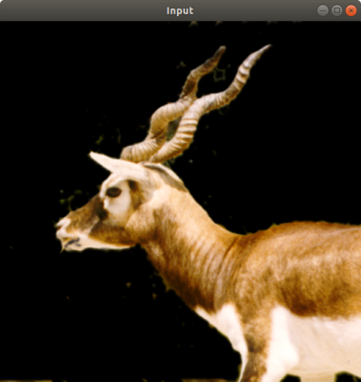
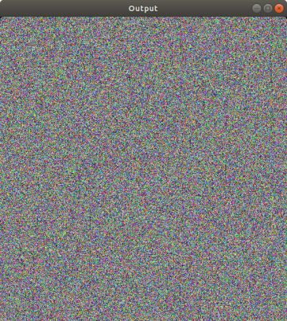
ps 2b: LFSR with PhotoMagic
Learnt thing(s):
The structure of a picture: pixel, color of each pixel (r,g,b)
How to load in and load out an image
sf::Image input;
if (!input.loadFromFile(argv[1])) {return -1;}
sf::Image output;
if (!output.loadFromFile(argv[1])){return -1;}
How to “XOR” each pixel’s color element with the lfsr.generate(int k);
sf::Image createOutput(sf::Image image, LFSR lfsr) {
sf::Vector2u size = image.getSize();
sf::Color p;
for (unsigned x = 0; x < size.x; x++){
for (unsigned y = 0; y < size.y; y++){
p = image.getPixel(x, y);
p.r ^= lfsr.generate(8);
p.g ^= lfsr.generate(8);
p.b ^= lfsr.generate(8);
image.setPixel(x, y, p);
}
}
return image;
}

Slide 6
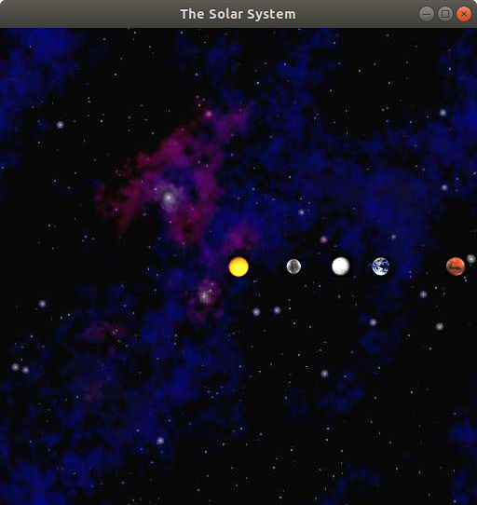
ps 3a: N-BODY SIMULATION
Learnt thing(s):
The virtual function and its uses in the draw function
virtual void draw(sf::RenderTarget &target, sf::RenderStates states) const;
The friend function and its uses in overloading operator >> for input stream
friend std::istream &operator >> (std::istream &in, Body &planet);
Interested thing(s):
Review the manipulation with sprites and texture in ps0 assignment

Slide 7
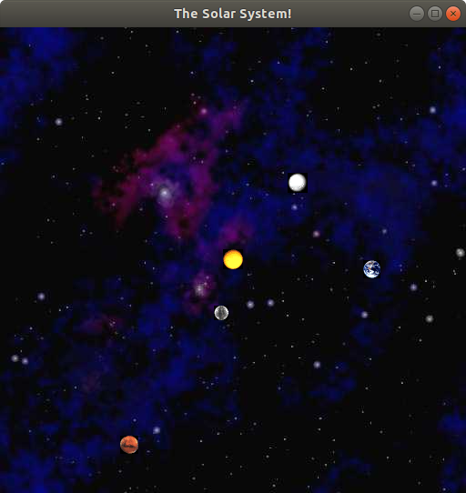
ps 3b: N-BODY SIMULATION
Learnt thing(s):
The step function with a time parameter (double seconds) and moves the Body object given its internal velocity for that much time
void step(double seconds, Body **Planets, int planet);
How to update positions of the Planets. Using this function helps to draw the moving track of each planet.
void updatePosition(float scale, int windowX, int windowY); // in nbody.hpp
//drawing planets
for (int i=0; i<numOfPlanets; i++){ (*Planets[i]).updatePosition(scale, size.x*1/2, size.y*1/2); window.draw(*Planets[i]);
}
Interested thing(s):
How to set the planets ‘s icons moving on the texture

Slide 8
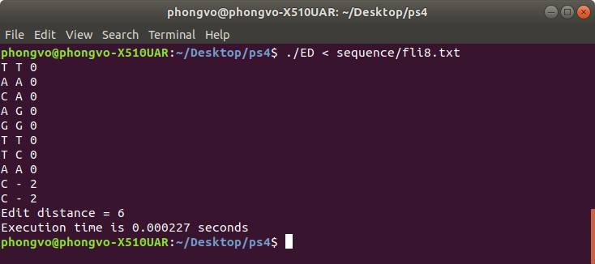
ps 4: DNA SEQUENCES ALIGNMENT
Learnt thing(s):
How to implement the DNA sequences alignment
Needleman – Wunsch method per the Princeton problem
Dynamic programming, that accumulates the calculations
Interested thing(s):
Calculation the “cost” (Princeton assignment), that could be either 2, 1 or 0.
opt[i][j] = min(opt[i+1][j+1] + penalty(string1[i],string2[j]), opt[i][j+1]+2, opt[i+1][j]+2);
Result:
std::string result = edit_distance.Alignment();

Slide 9
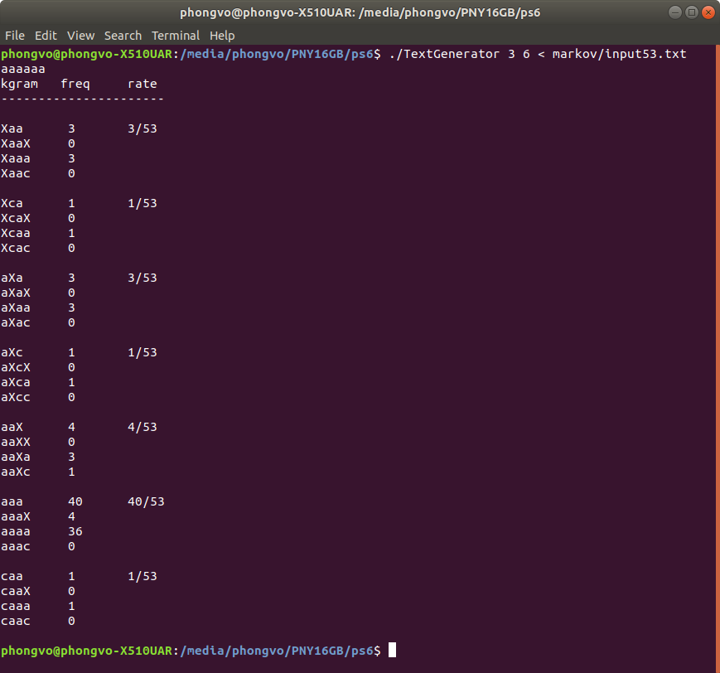
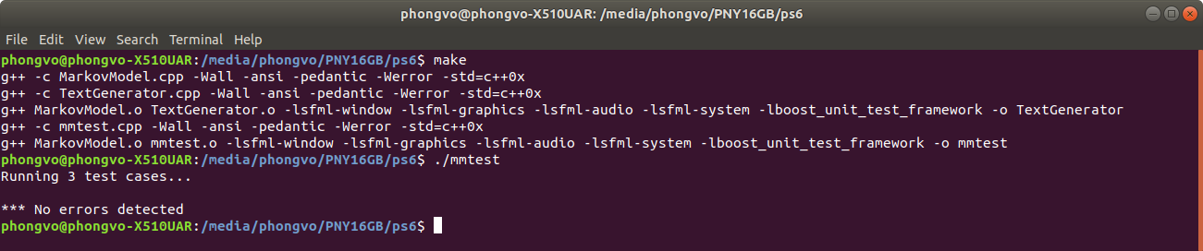
ps 6: MARKOV MODEL OF NATURAL LANGUAGE
Learnt thing(s):
Definition of k-gram and the following
letter
Running the mmtest.cpp file to test my
implementation
Interested thing(s):
Making a statistic table of k-grams mentally
and by coding

